Slide 1
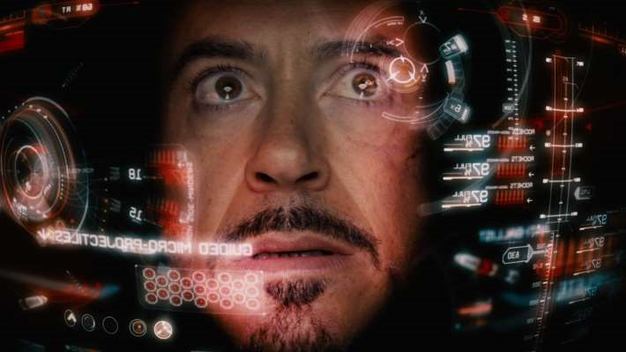

Slide 2

Artificial intelligent
Using python
Grop NO. 5
CO-6-I

Slide 3
AGENDA
INTRODUCTION
OVERVIEW
FEATURES
HOW IT WORKS?
ADVANTAGES -
DISADVANTAGES
COMMANDS
SETUP
CONCLUSION

Slide 4
INTRODUCTION
The character has appeared heavily in media
adaptations of iron man and avengers stories.
It is commonly reimagined as "just a rather very
intelligent system"
The name is comes from Edwin Jarvis who is the loyal
household butler of tony stark.

Slide 5
OVERVIEW
Jarvis is a digital life assistant.
Based on the PYTHON language.
It is an open source software.
Jarvis assists with your daily life by acting as an
Alarm clock,
Informing you of the latest news headlines,
The forecast of the weather for the upcoming days.

Slide 6
FEATURES
•
Answering complex questions
•
Solving maths equations
•
Reading social network messages
•
Conversing
Energy savings efficiency

Slide 7
HOW IT WORKS?
I. Speak something(for e.g. “Hello”)
II. Jarvis records the voice and match with available commands
III. f it is available then proper response is provided
And proper action is taken

Slide 8
ADVANTAGES
Easy to use
Can work with variety of commands
Custom commands
Secure
Helpful for disabled
Artificial intelligent

Slide 9
DISADVANTAGES
Costly
Expensive equipments
It cannot work in noisy environment

Slide 10
COMMANDS
•
There are mainly 3 types of Commands as are given,
•
Shell
C
ommands
•
Web
C
ommands
•
Social Commands

Slide 11
SETUP
The necessary components for setting up Jarvis are as
given below:
Speech recognition software
Sounds

Slide 12
CONCLUSION
Jarvis is a digital and virtual assistant with artificial
intelligency.
It is very flexible and useful technology.
It provides a better interface to deal with it.

Slide 13
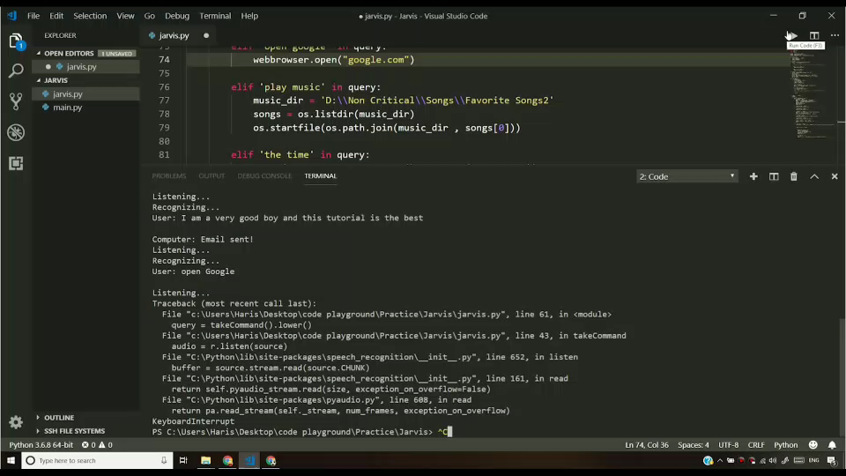

Slide 14
Thank You

